Slide 1
Managing Users and Groups
Assume Superuser Privileges
Create, Modify, and Delete Users
Create, Modify, and Delete Groups
Query Users and Groups
Configure Account Profiles

Slide 2
User Accounts
An object that represents a person's identity to the operating system and is used to perform certain tasks.
User info includes group memberships.
Individuals should have their own unique accounts.
Admins use accounts to control access.
System references accounts by UID.
Accounts have several attributes.

Slide 3
Types of User Accounts
Root user
Plays role of local admin.
Provides security context for apps and commands.
More powerful than local admin in Windows.
Standard user
Represents regular human user.
Most tasks only require standard user privileges.
Can also be configured to assume root privileges when needed.
Service user
Represents apps that consume system resources.
Disabled for regular log on.
Usually owns configuration files and/or executables.

Slide 4
Superuser
The local administrative account on a Linux system, typically named root.
Used to manage users, configure devices, etc.
System runs services as root.
May run potentially destructive commands.
Best practice is to not log on as root.
Elevate privileges from non-privileged account when necessary.

Slide 5
Principle of Least Privilege
A best practice that states that users should have as much access as is required to do their job, but no more than that.
Example: User needs to read but not write to a file.
Only give user read access.
Example: User needs to restart but not reconfigure.
Only give user restart privileges.
Easier to give more access than take away existing access.
Enhances security of the system.

Slide 6
The su Command (Slide 1 of 2)
Used to substitute user/elevate privileges.
Without option, switches identity to given user.
Retains original user's profile/variables.
Switched user remains in home directory of original user.
Prompts for password of switched user.
With a hyphen, launches new shell for switched user.
Better practice.
Also prompts for password.

Slide 7
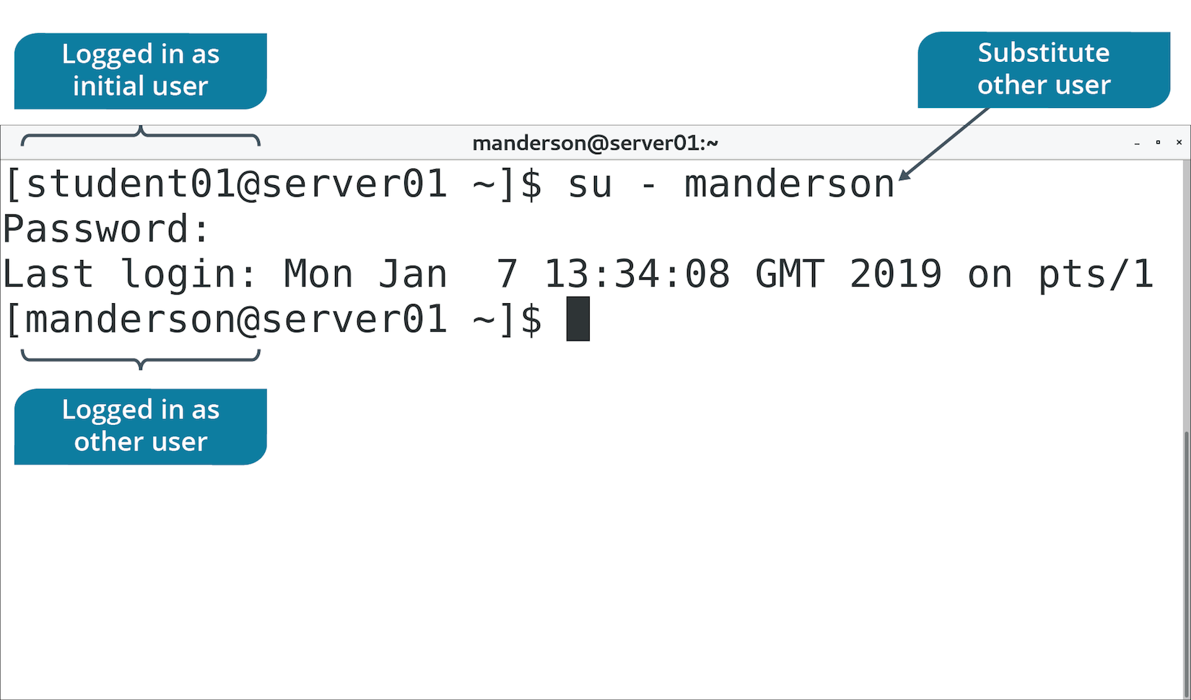
The su Command (Slide 2 of 2)

Slide 8
The sudo Command
Using su - root is usually more power than necessary.
sudo is used to execute specific commands as root.
Delegate access in /etc/sudoers file.
Use visudo editor.
You can give users permission to run specific commands.
Avoids giving users full admin privileges.

Slide 9
The sudoedit Command
Simpler and more secure option of editing files with other privileges.
User can use preferred text editor to open file.
Example entry in sudoers:
%editors ALL = sudoedit /path/to/file
Members of editors can enter sudoedit /path/to/file
sudo is better for running commands, sudoedit for files.

Slide 10
The visudo Command (Slide 1 of 2)
Don't edit /etc/sudoers with a normal text editor.
Mistakes can render server inoperable.
visudo command verifies syntax before committing changes.
Can correct mistakes before they become official.

Slide 11
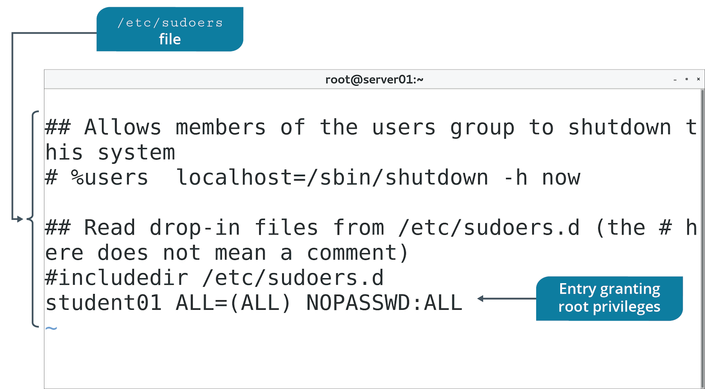
The visudo Command (Slide 2 of 2)

Slide 12
The wheel Group
Some distros disable root altogether.
Enable admin privileges by membership to wheel group.
Less potential for damaging system.
Use visudo to edit wheel group's privileges.
Add users to wheel group to give them privileges.
Be cautious about wheel group membership.

Slide 13
Discussing Superuser Privileges

Slide 14
Activity: Assuming Superuser Privileges
You've been told about the dangers of using root account.
Users should have no more access than needed.
Develetech policy states admin access should be carefully controlled.
You need to identify how to satisfy this requirement.

Slide 15
The useradd Command
Creates user accounts and configures user settings.
Creates account in /etc/passwd file.
References /etc/login.defs for configs.
Creates user's home directory in /home/<account name>
Populates home directory from files in /etc/skel
No password set by default.
Will exist, but not usable.

Slide 16
useradd Command Options
Option | Description | Example
-c | Sets comment field. | useradd -c "User One" user1
-e | Sets account expiration date. | useradd -e 2019/12/31
-s | Sets user's default shell. | useradd -s /bin/ksh
-D | View default config for new users. | useradd -D

Slide 17
The passwd Command (Slide 1 of 2)
Used by root to set/reset user's password.
User can reset own password with command.
Also used after useradd to set initial password.

Slide 18
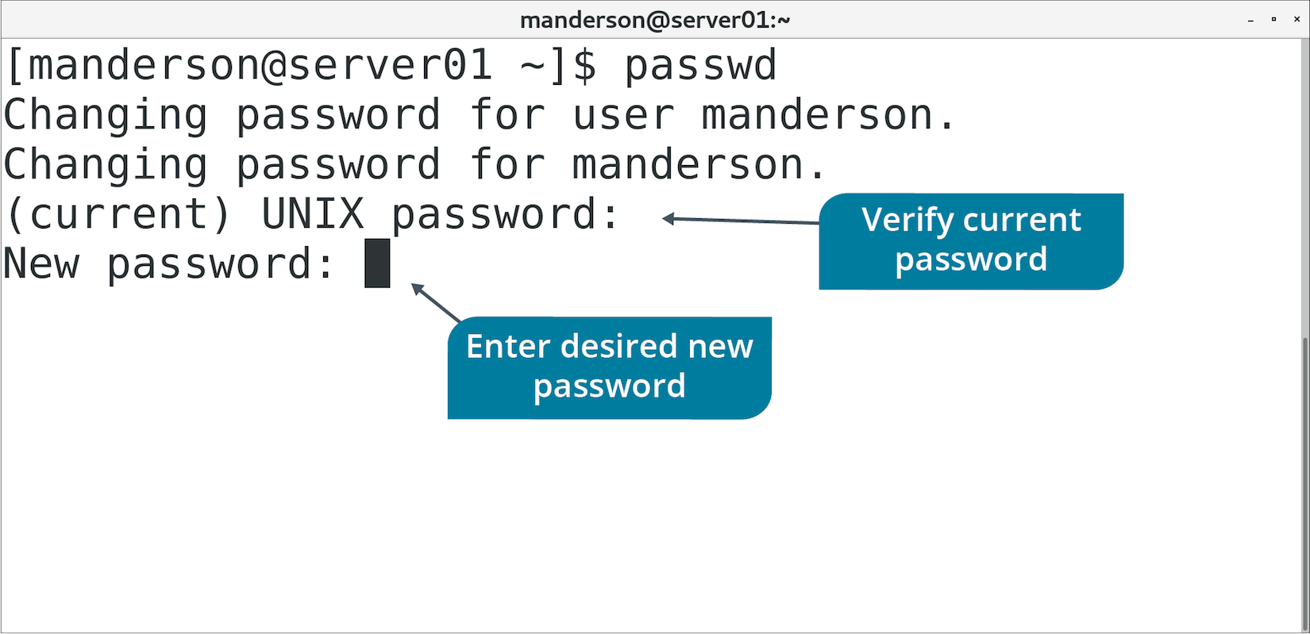
The passwd Command (Slide 2 of 2)

Slide 19
The /etc/passwd File
Stores account info.
All accounts found here.
Contains 7 fields separated by colons.
Field | Content
User name | Name user logs into system with.
Password | Password assigned to user (x means stored elsewhere).
User ID | Unique number representing user.
Group ID | Unique number of user's primary group.
Comment | User's full name (usually).
Home directory | Path to user's home directory.
Login shell | Path to shell launched when user logs in.

Slide 20
The /etc/shadow File (Slide 1 of 2)
/etc/passwd used to store hashed version of passwords.
Any user could see any other user's hash.
Passwords more easily cracked.
/etc/shadow is modern file location of hashed passwords.
Only root has access.
Includes addition info like password requirements and expiration info.

Slide 21
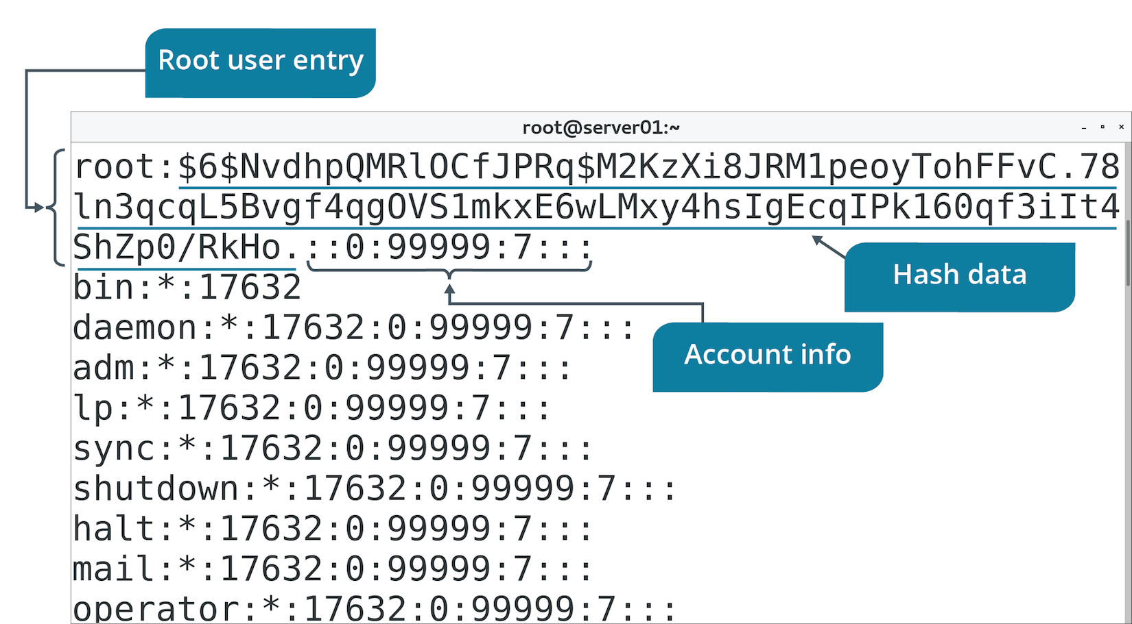
The /etc/shadow File (Slide 2 of 2)

Slide 22
Activity: Creating User Accounts
Managing user accounts is a responsibility for admins at Develetech.
You'll start by creating user accounts and viewing defaults.

Slide 23
The chage Command
"Change age"
Controls password expiration, warnings, inactive days, etc.
Option | Description | Example
-E | Sets account expiration at date/time. | chage -E 2022/12/31 user1
-l | Lists password aging info. | chage -l user1
-M | Sets max days password is valid for. | chage -M 90 user1
-m | Sets minimum days until password can be changed. | chage -m 1 user1
-W | Sets number of days before expiration user will be warned. | chage -W 5 user1

Slide 24
The usermod Command
Modifies settings for regular users.
Edits /etc/passwd file.
Option | Description | Example
-c | Sets comment field. | usermod -c "User One" user1
-e | Sets account expiration date. | usermod –e 2020/12/31 user1
-aG | Adds user to group, keeping them in existing groups. | usermod –aG sales-group user1
-l | Changes user's login name. | usermod –l user99 user1

Slide 25
Lock User Login
Locking account renders it unusable.
Still exists.
Can be unlocked when needed.
Lock:
passwd -l {user name}
usermod -L {user name}
Unlock:
passwd -u {user name}
usermod -U {user name}

Slide 26
Activity: Modifying User Accounts
You want to ensure accounts you created exist.
You'll set password requirements.
You'll investigate expiration/locking functionality.

Slide 27
The userdel Command
Deletes user accounts.
Doesn't delete home directory unless you use -r option.
Removes references to account.
Use caution before deleting accounts.

Slide 28
Discussing Creating, Modifying, and Deleting Users

Slide 29
Activity: Deleting a User Account
Part of user account lifecycle is to delete accounts no longer needed.
You'll delete a test account.

Slide 30
Group Accounts
Access control objects that contains multiple users with similar security requirements.
Simplify admin tasks.
Multiple users can be granted permissions.
Represented by GID.
User can be member of multiple groups.

Slide 31
The /etc/group File (Slide 1 of 3)
Storage location for groups.
Commonly referenced for group info.
Don't manually edit file; use group commands.
Contains four fields separated by colons.

Slide 32
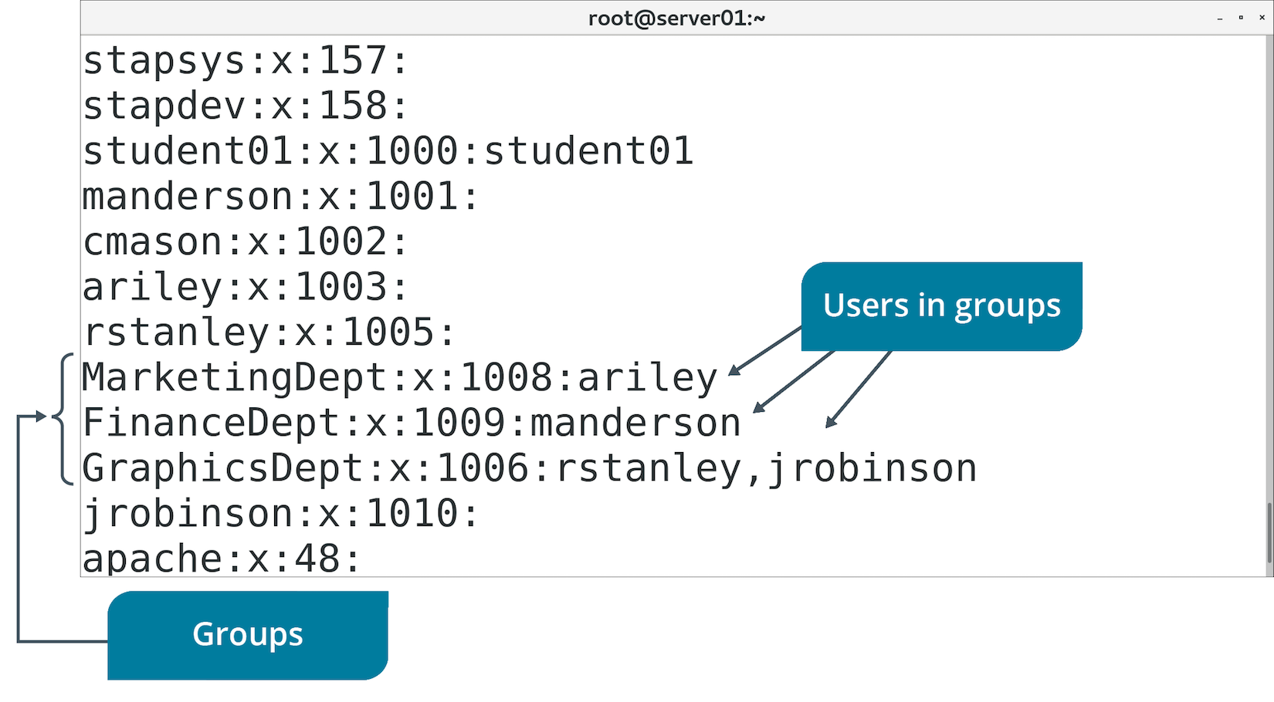
The /etc/group File (Slide 2 of 3)

Slide 33
The /etc/group File (Slide 3 of 3)
Field | Description
Group name | User-friendly name of group.
Password | Password required to enter group.
Group ID | GID by which system references group.
Group list | List of all group members.

Slide 34
The groupadd Command
Creates groups.
Group has no members/password by default.
Specify GID with -g option.
Option | Used To | Example
-g | Assign a group ID. | groupadd –g 123 sales
-f | Exit with success if group already exists. | groupadd –f sales
-o | Allow group creation with non-unique ID. | groupadd –o –g 123 sales

Slide 35
The groupmod Command
Changes group's attributes.
Edits /etc/group file.
Option | Used To | Example
-g | Change group ID. | groupmod –g 123 sales
-n | Rename group. | groupmod –n newsales sales

Slide 36
The groupdel Command
Deletes groups from /etc/group file.
Doesn't delete users.
Exercise caution when deleting groups.

Slide 37
Discussing Creating, Modifying, and Deleting Groups

Slide 38
Activity: Creating, Modifying, and Deleting Groups
You need to group users together to make management easier.
Groups will correspond to different departments.
You'll need to rename Graphics group to fit naming scheme.
You'll add users to groups.
You'll finish by deleting a group.

Slide 39
Account Querying
Admins may need to gather identity info.
Several commands can report user/group info.
Useful for troubleshooting problems.
Useful for verifying accounts logged in.

Slide 40
The whoami Command (Slide 1 of 2)
Displays user name you're currently logged in as.
You may need to switch users.
Not sure which one you're using at a given time.
Can also verify user name.

Slide 41
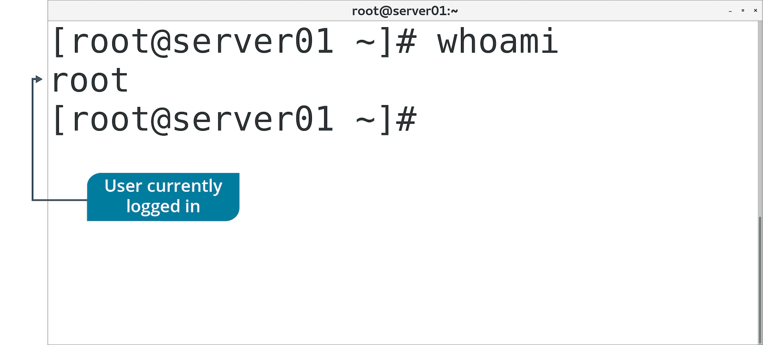
The whoami Command (Slide 2 of 2)

Slide 42
The who Command (Slide 1 of 2)
Determines details of users currently logged in.
Includes:
User name.
System user is connected to.
Date/time connected since.

Slide 43
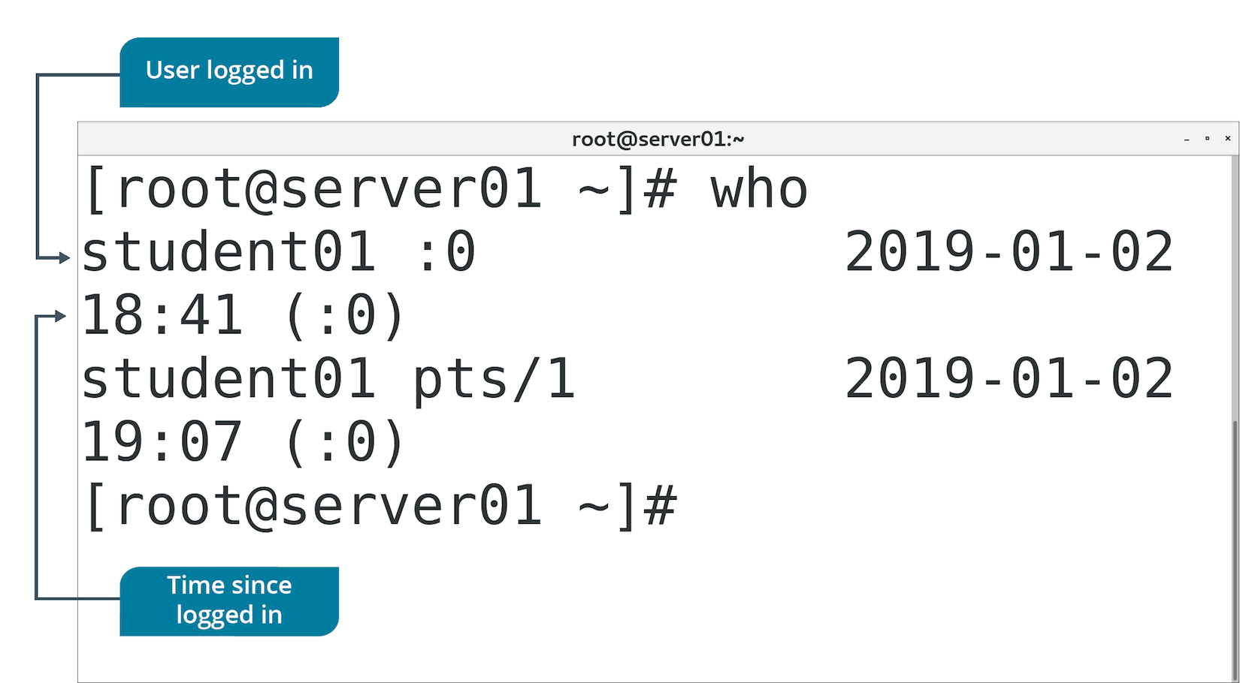
The who Command (Slide 2 of 2)

Slide 44
The w Command (Slide 1 of 2)
Displays details of logged in users and transactions.
First line displays status of system.
Second line displays table.
First column: users logged in.
Last column: current activities of users.
Other columns: various attributes of users.

Slide 45
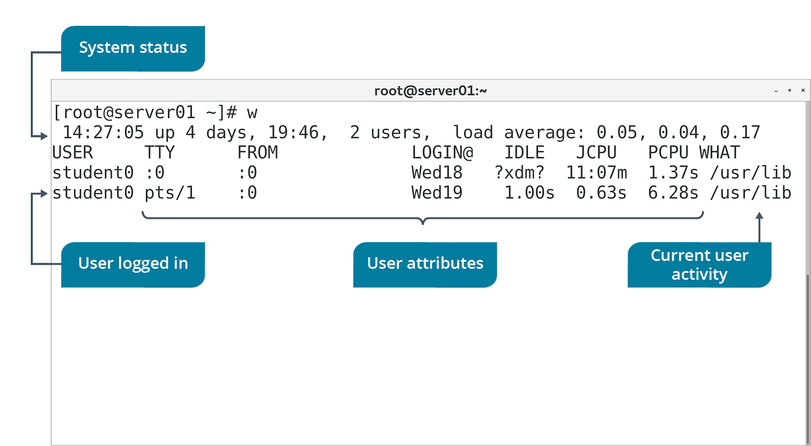
The w Command (Slide 2 of 2)

Slide 46
The last Command (Slide 1 of 2)
Displays history of user login/logout.
Options enable filtering of users by terminal.
last 1 filters results by users on first terminal.
Retrieves info from /var/log/wtmp file.

Slide 47
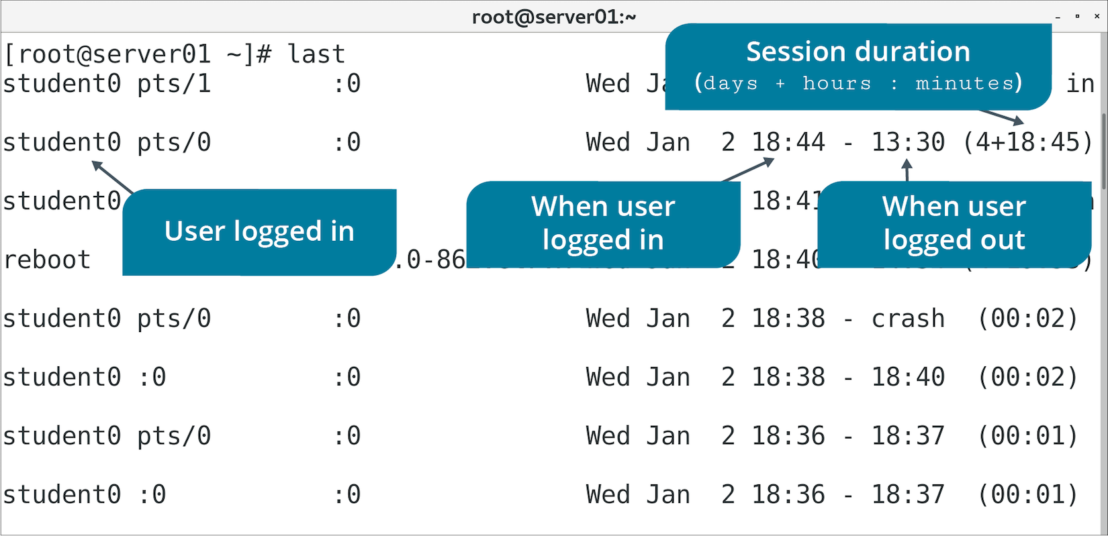
The last Command (Slide 2 of 2)

Slide 48
The id Command (Slide 1 of 2)
Displays UID/GID.
Without options, displays info about logged in user.
You can specify user name to display info about that user.

Slide 49
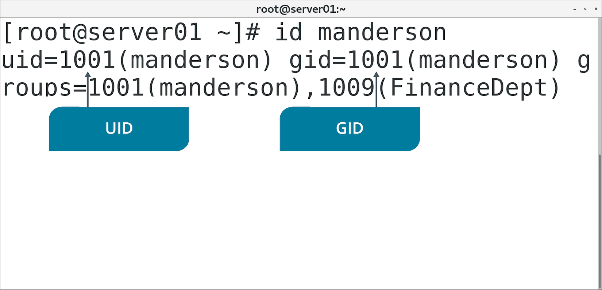
The id Command (Slide 2 of 2)

Slide 50
Discussing Querying Users and Groups

Slide 51
Activity: Querying Users and Groups
Several ways of gathering user/group info and logged in users.
You'll explore methods to answer any support questions.
Develetech policy requires log file of user logins.

Slide 52
User Profiles
Individual users have habits and preferences for working with Linux.
Profile file configurations exist to customize experience.
Initial profile is created when account is created.
Many files/directories are used to create profile.

Slide 53
The .bashrc File (Slide 1 of 2)
Enables customization of user's environment.
Stored in home directory.
Unique to each user.
Example: Use of aliases.
Users can specify abbreviated commands for themselves.
Won't impact other users.
Example: Environment variables.
Example: Customize command prompt.

Slide 54
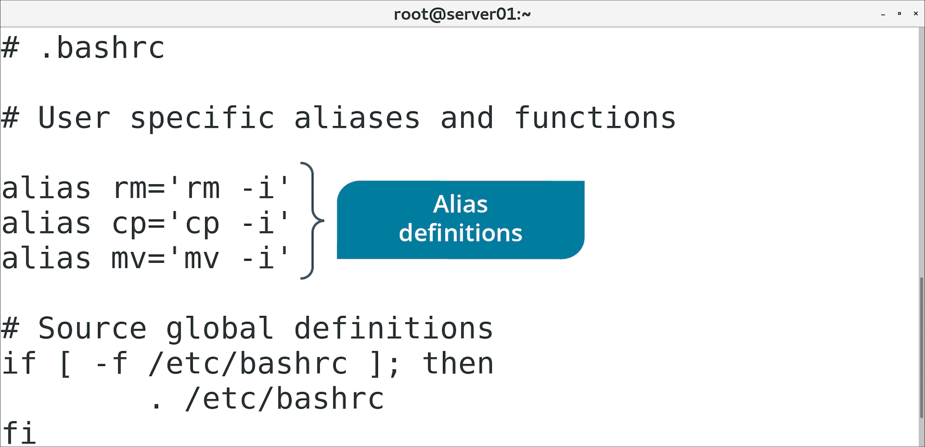
The .bashrc File (Slide 2 of 2)

Slide 55
The .bash_profile File (Slide 1 of 2)
Provides shell configuration for initial login.
Only read with first login.
.bashrc is read with all logins.
Default can be provided through /etc/skel/ directory.

Slide 56
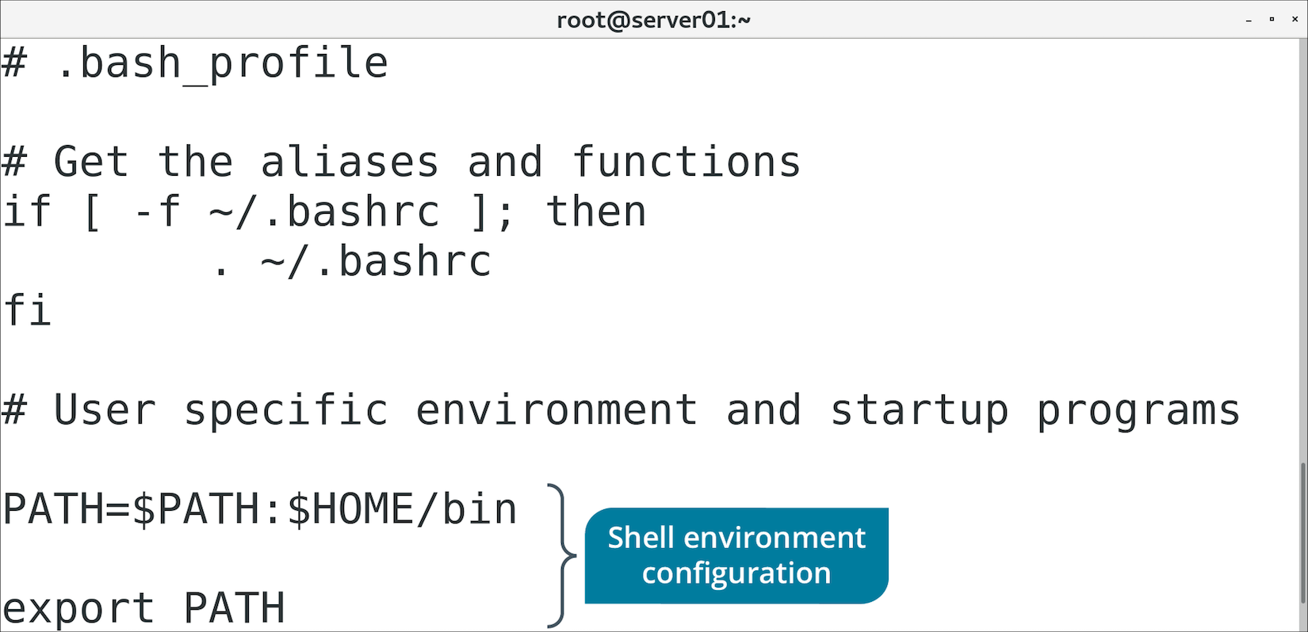
The .bash_profile File (Slide 2 of 2)

Slide 57
Global User Profiles
Admin may want to define system-wide settings.
Admin may want to configure initial settings for users.
Following files/directories enable flexible configurations.
Can be later customized by user.

Slide 58
The /etc/skel/ Directory
Contents are automatically copied to home directory of new users.
Admin can pre-populate directory.
useradd copies contents from directory.
Files added after account is created won't be copied.

Slide 59
The /etc/profile File
Provides system-wide environment variables.
Configure if settings need to apply to all users.
During login process:
/etc/profile checked first for shell configs.
User customizations then pulled from .profile in home directory.
Admins can define global shell settings, but still allow user-specific customization.

Slide 60
The /etc/profile.d/ Directory
Storage location for scripts used to set system-wide variables.
Recommended to set variables in scripts here.
Rather than edit /etc/profile directly.

Slide 61
The /etc/bashrc File
Provides system-wide Bash settings.
Different than /etc/profile (used for variables).

Slide 62
Discussing Account Profiles

Slide 63
Activity: Configuring Account Profiles
You're concerned that changes may be difficult for users.
You need to customize user environments for consistency.
You need to place a copy of policies in each new user's home directory.

Slide 64
How might you design groups in your organization?
How might you manage root privileges in your organization?

